Slide 1
Health Protection Surveillance Centre
Surveillance of outbreaks of infectious disease in Ireland:
Q3 2019 provisional data
December, 2019

Slide 2
Provisional data, Q3 2019

Slide 3
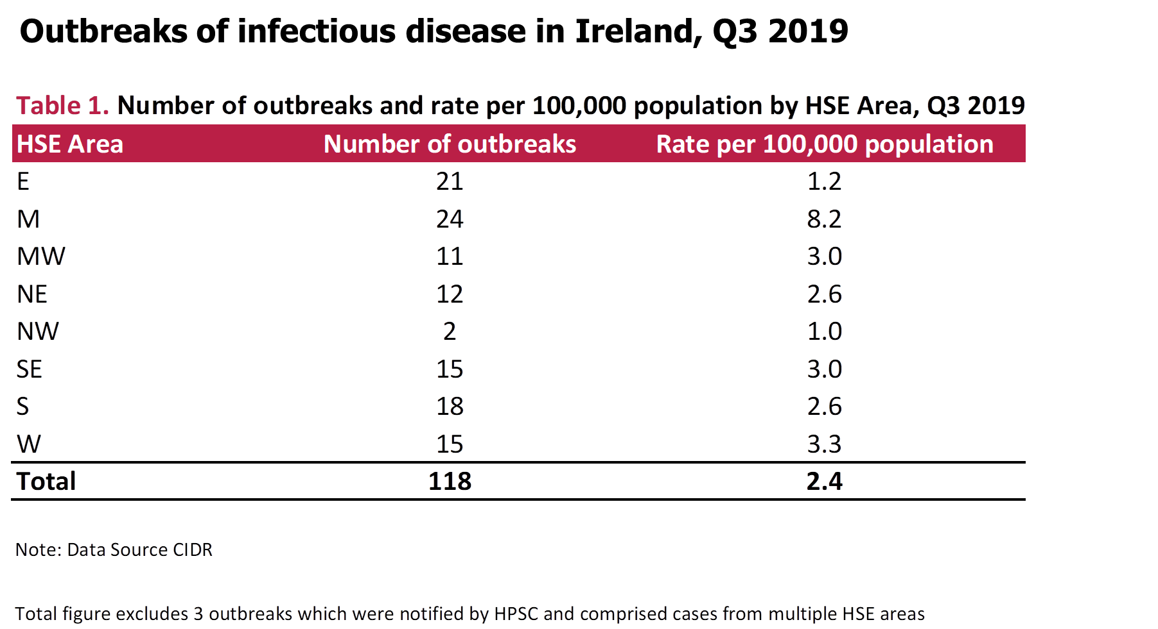

Slide 4
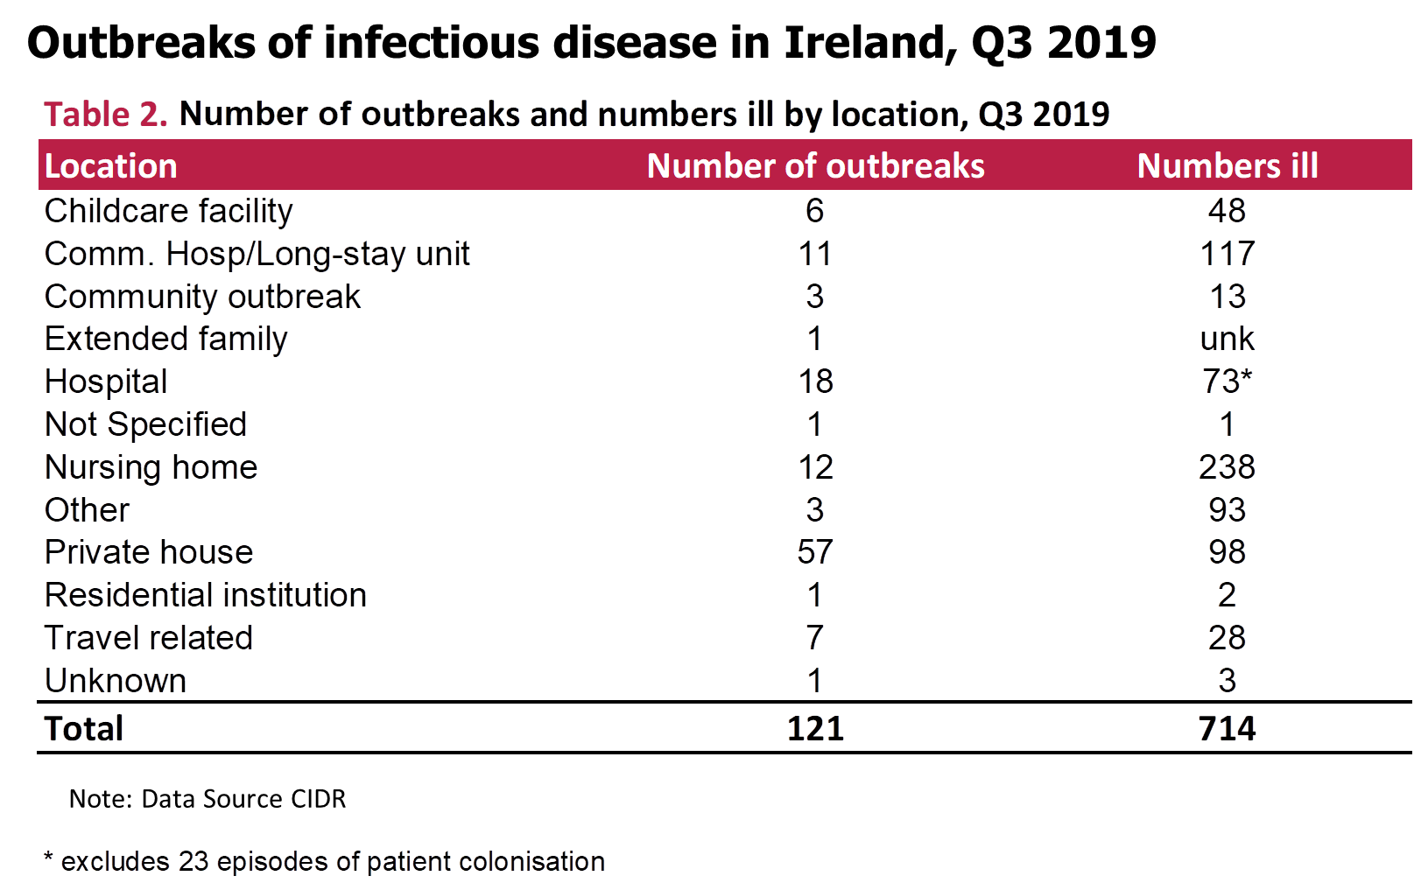

Slide 5
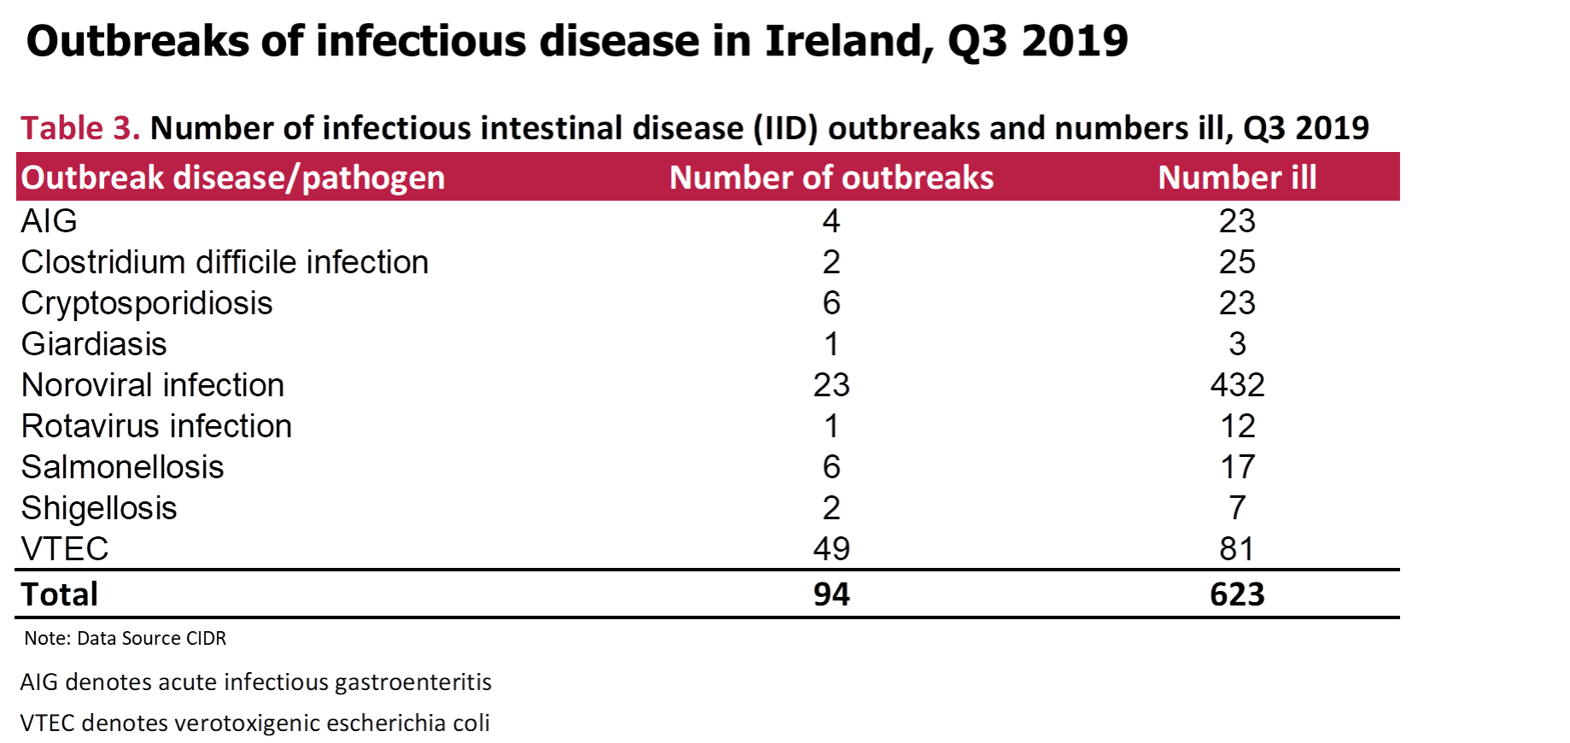

Slide 6
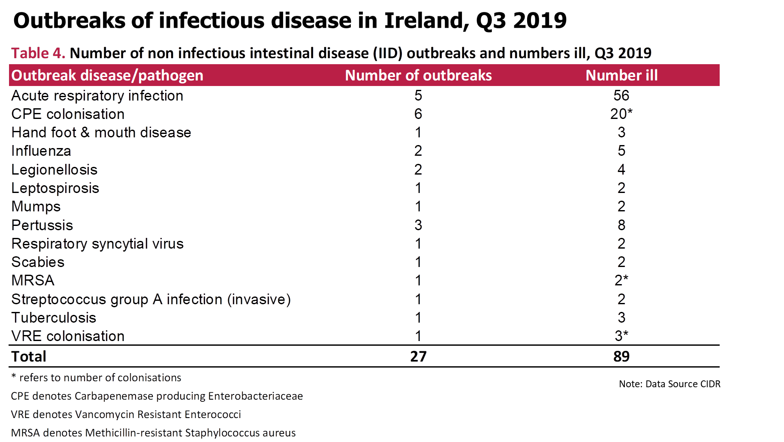

Slide 7
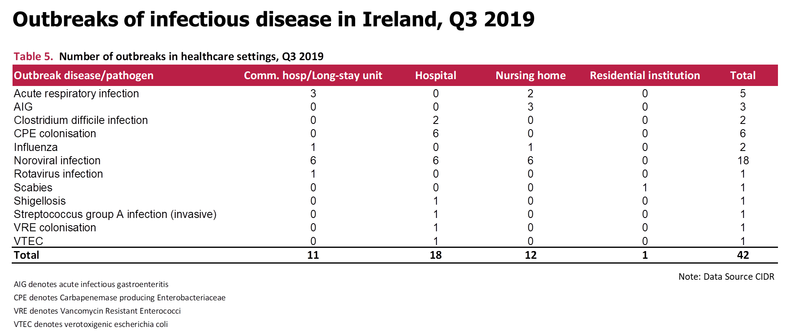

Slide 8
Further Information
Further information on outbreaks can be found at
https://www.hpsc.ie/a-z/outbreaks/

